Slide 1

Stroop
Pro
11911138 徐格蕾
11911740 林雨诗
11911737 林小璐
11813208 曾焓
12011702 张镇涛

Slide 2

DIRECTORY
Background
Experiment Design
Implementation Design
Result Analysis
Summary

Slide 3
Part 1:
BackGround
This part we will introduce the background of original Stroop Experiment
A

Slide 4

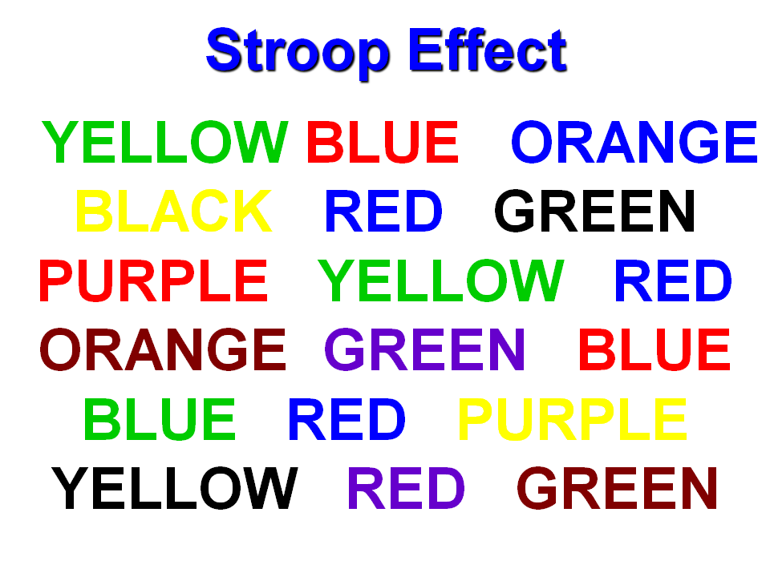
Backgroud
Psychologist Stroop conducted an interesting experiment in 1935. He presented the subjects with a series of color blocks and asked them to read the colors aloud they saw as soon as possible.
Finally, the subjects were presented with some words that express colors. Each word is not the same as the color indicated.

Slide 5
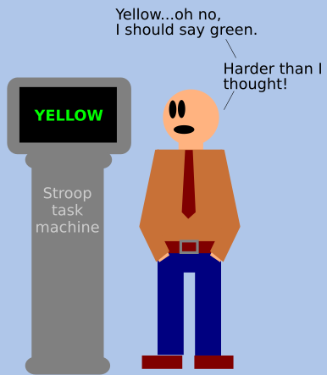
Application
Nowadays, various Stroop experiments (different versions of the Stroop test, also known as different paradigms) are often used to test the inhibitory ability(抑制能力) of subjects in executive function.
Based on this experiment, we extend the cases to pictures and calculation quiz to test people’s reaction.

Slide 6
Part 2:
Experiment Design
This part we will introduce how we design our experiment to improve the original one
B

Slide 7
The original one is just testing the influence of color on human’s cognition, so we wonder if we can increase more variables to explore deeper in this topic
STRUCTURE of QUESTIONS
Time
Each participant tests for five times successively
Chinese
Text Discrimination
English
All contain neural, negative and positive questions
Pin Yin
Form
Picture Recognition
Logical Thinking

Slide 8

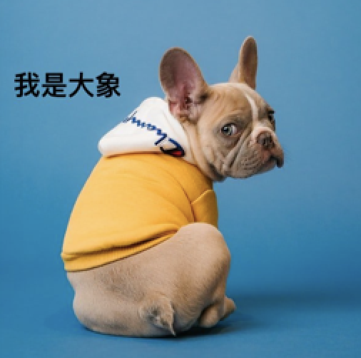
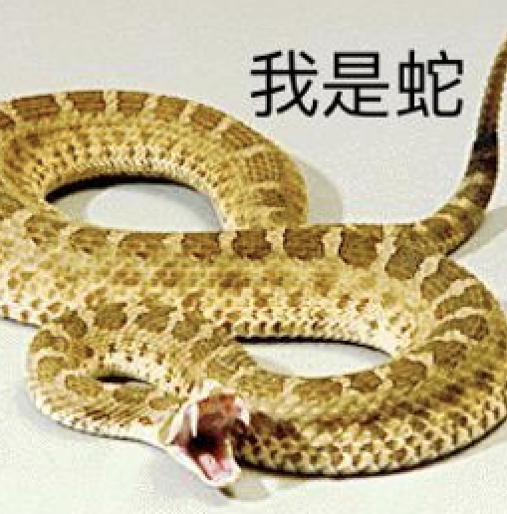
Details and Examples of Questions
Neural Negative Positive
Group 1 红色 绿色 蓝色
Group 2 Red Green Blue
Group 3 hóng sè lǜ sè lán sè
Group 4
Group 5 14*8-2*4 67*3+2*8 52*8-5*3 (tip:185) (tip:401)
Text Discrimination
Five Rounds
26*5*5=650 groups
Picture Recognition
Correctness
Cost time
Logical Thinking

Slide 9
Part 3:
Implementation Design
C

Slide 10
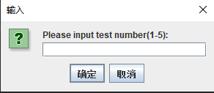
Implementation design
We prepared 5 sets of questions for each tester. Before you start answering these questions, you need to input the test number ,then the program will show you the corresponding question set.

Slide 11
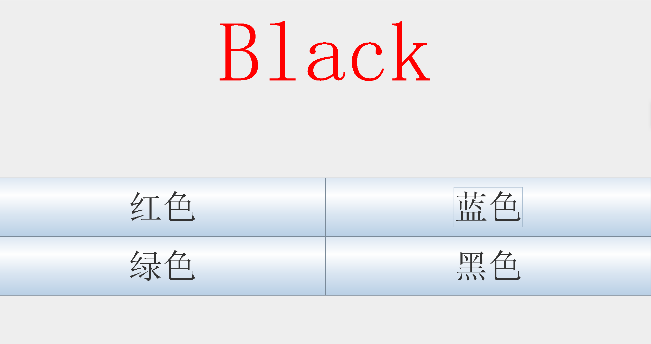
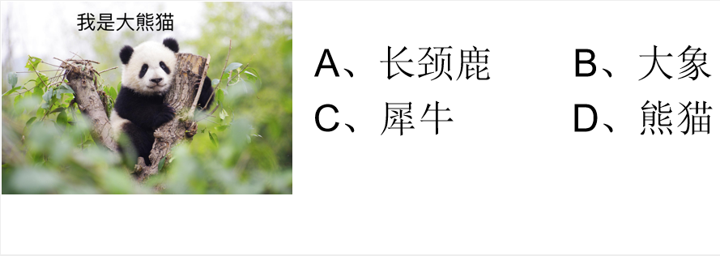
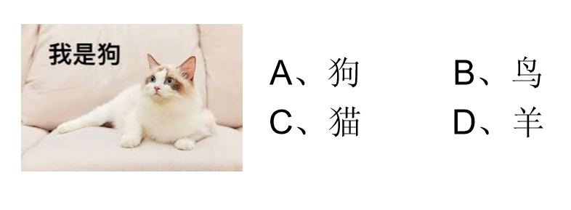
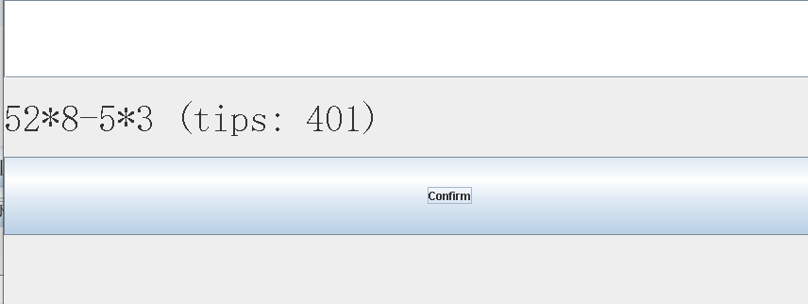
Question Example

Slide 12
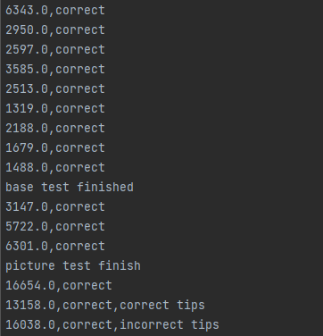
Time Recording
The program will start counting after show the question to tester and stop counting after tester answer the questions, then record the time and correctness of this questions

Slide 13
Time Recoding
The program will start counting after show the question to tester and stop counting after tester answer the questions, then recode the time and correctness of this questions

Slide 14
Part 4:
Result Analysis
This part we will introduce what the result shows.
D

Slide 15
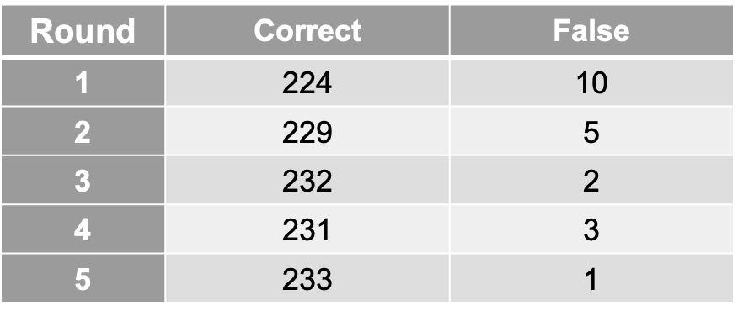
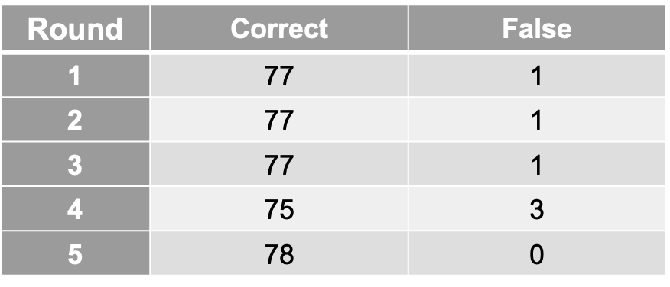
1. Analysis of the Accuracy
Base (text&color) Accuracy test result
Picture Accuracy test result
Notes:
由于单个人的数据量较少，准确率分析同样采用一个round/一题所有人数据加和的方式。
对于基础测试和图像测试，由于大家的准确率一直较高，因此无法得出较为明显的规律。只能看出，随着round的增多，大家对题目逐渐熟悉，准确率也有轻微上升。

Slide 16
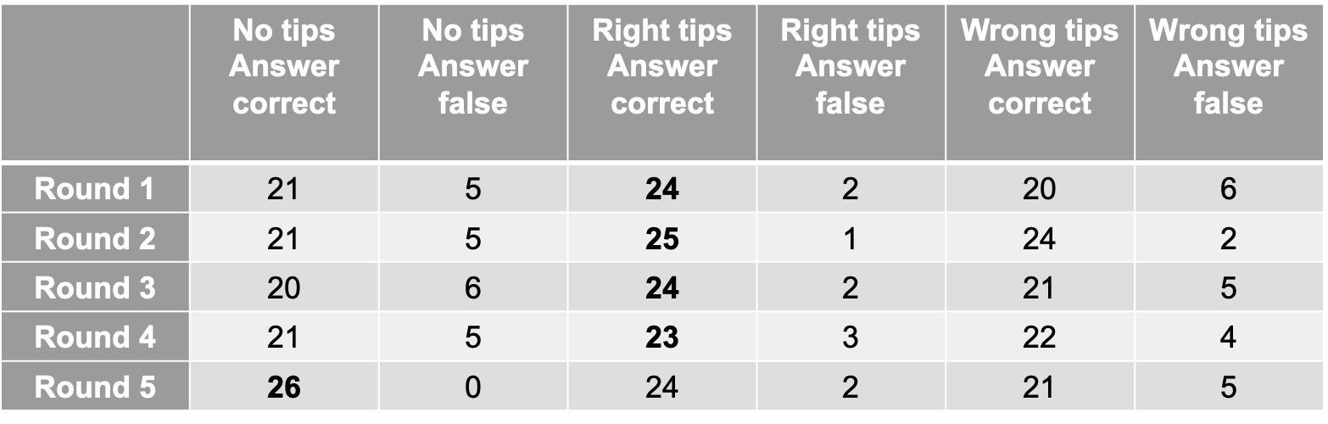
1. Analysis of the Accuracy
Calculate Accuracy test result
Right tips can gain accuracy to some certain extent!
Notes:
对于计算测试，结果分为了6类：分别为无tips，有正确tips和有错误tips情况下回答正确和错误的次数。可以明显发现，在正确的tips帮助下，答对的人数在绝大多数情况下高于无tips和错误tips，而无tips和错误tips答对答错人数基本持平。说明在大家认真计算的时候，正确的tips可以助于提高准确率，而错误的tips对准确率无明显变化。综合反应时间来看，在有错误tips的时候，当大家得出答案与tips不同是会花额外时间进行验证，因此所花费时间较无tips更多而准确率持平。

Slide 17
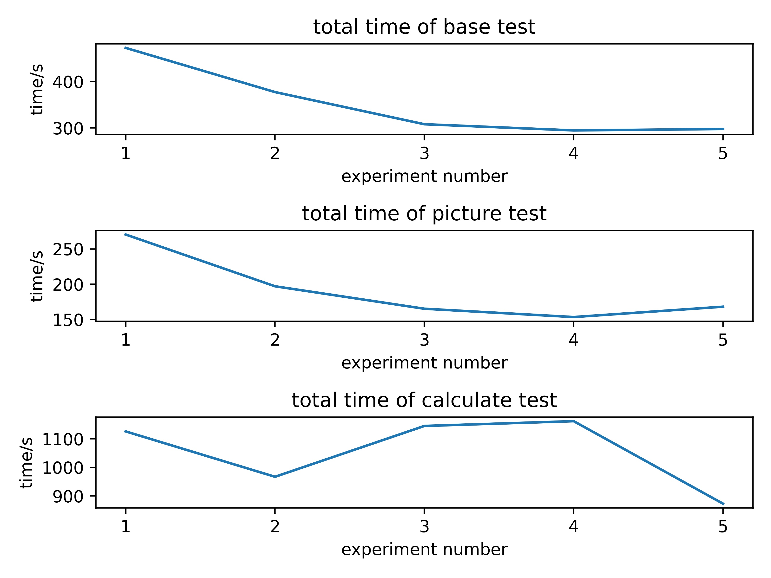
2. Analysis for Time Changes
Notes:
分析一：针对时间变化的分析
直观视觉接收信息适应性强，随着round的增加时间呈明显下降趋势
涉及逻辑思考方面的时间较为稳定，不容易随着次数增加而减少

Slide 18
3. Analysis of each Round Tests for Different Feedbacks
neutral feedback (0)
positive feedback (+)
negative feedback (-)
Text Discrimination
Image Recognition
Logical Thinking (Calculation)
Different feedbacks
Different question types

Slide 19
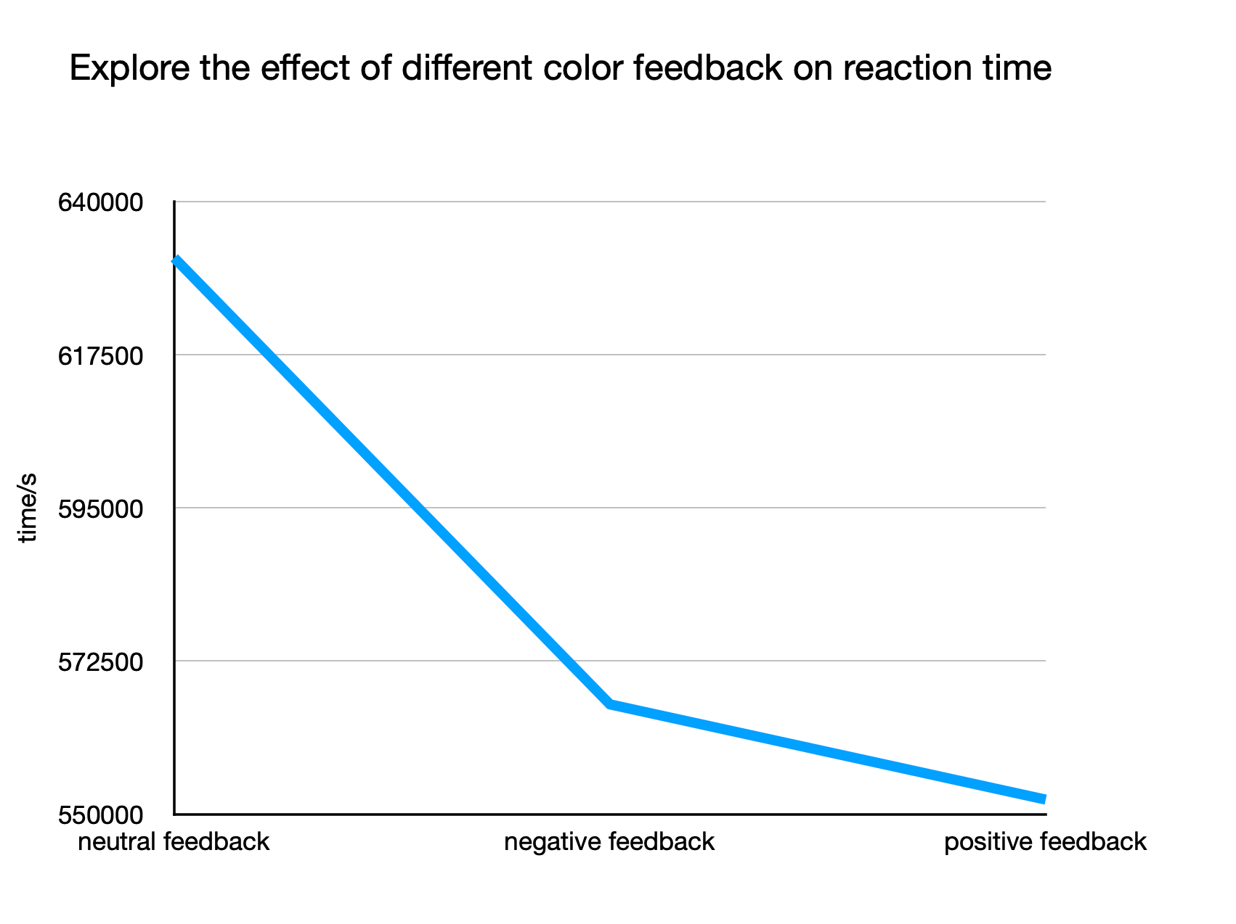
Analysis of each Round Tests for Different Feedbacks
Text Discrimination
Notes:
（1）不同反馈对文字辨别的影响
正向反馈可以明显促进认知的反应速度
中性反馈和负向反馈之间呈现出与预计不相同的结果，经分析，可能是由于每组测试的中性反馈存在一个不同语言的认知转变，从而可以间接得出不同语言的转换干扰的影响因子比视觉上的颜色干扰更大

Slide 20
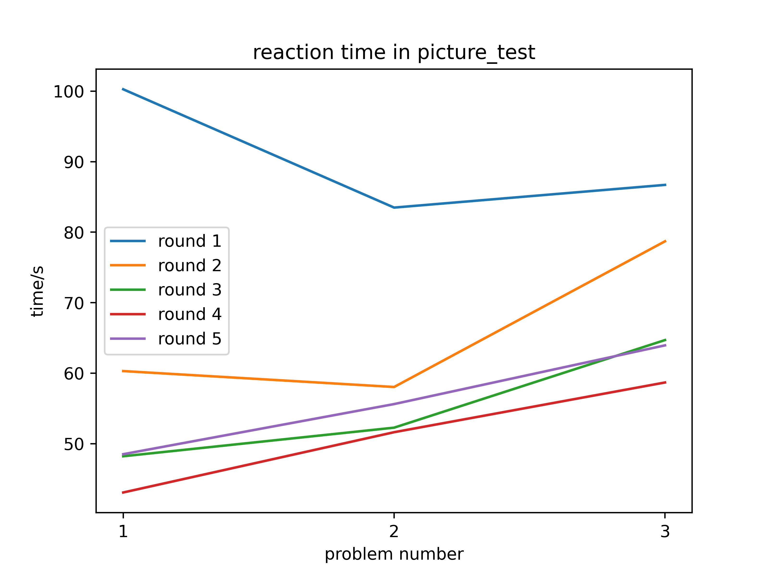
Analysis of each Round Tests for Different Feedbacks
Image Recognition
Neutral feedback
Positive feedback
Negative feedback
Notes:
（2）探究不同反馈对图像识别的影响
无图片干扰的反应速度最快，而图像和文字为负反馈干扰时的反应速度最慢，整体符合预计期望

Slide 21
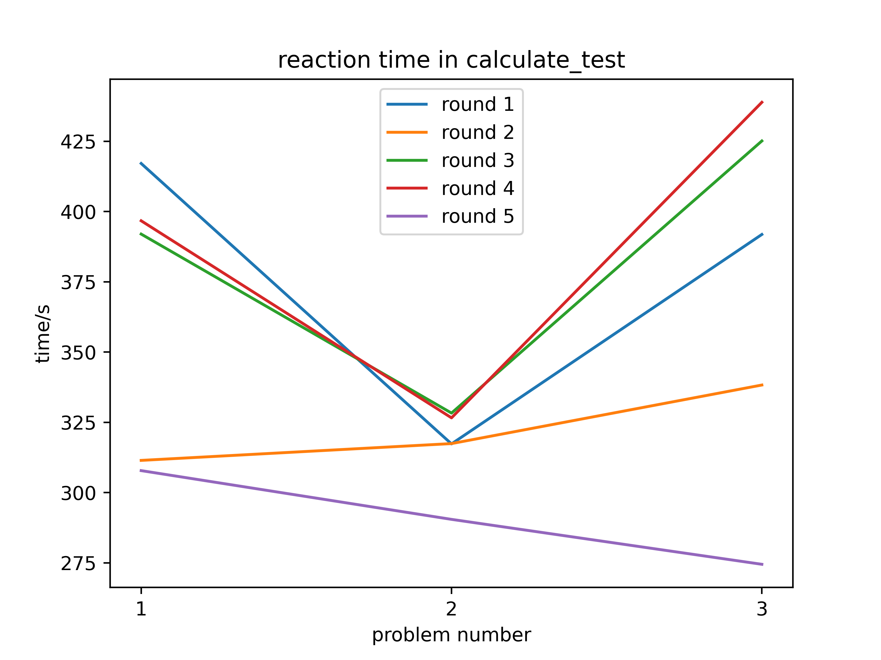
Analysis of each Round Tests for Different Feedbacks
Logical Thinking (Calculation)
Neutral feedback
Positive feedback
Negative feedback
Notes:
3）探究不同反馈对逻辑思考的影响
无答案的中性反馈和错误答案的负向反馈所用时间差距较小，而正确答案的正向反馈带来的影响较大，明显带来促进的作用

Slide 22
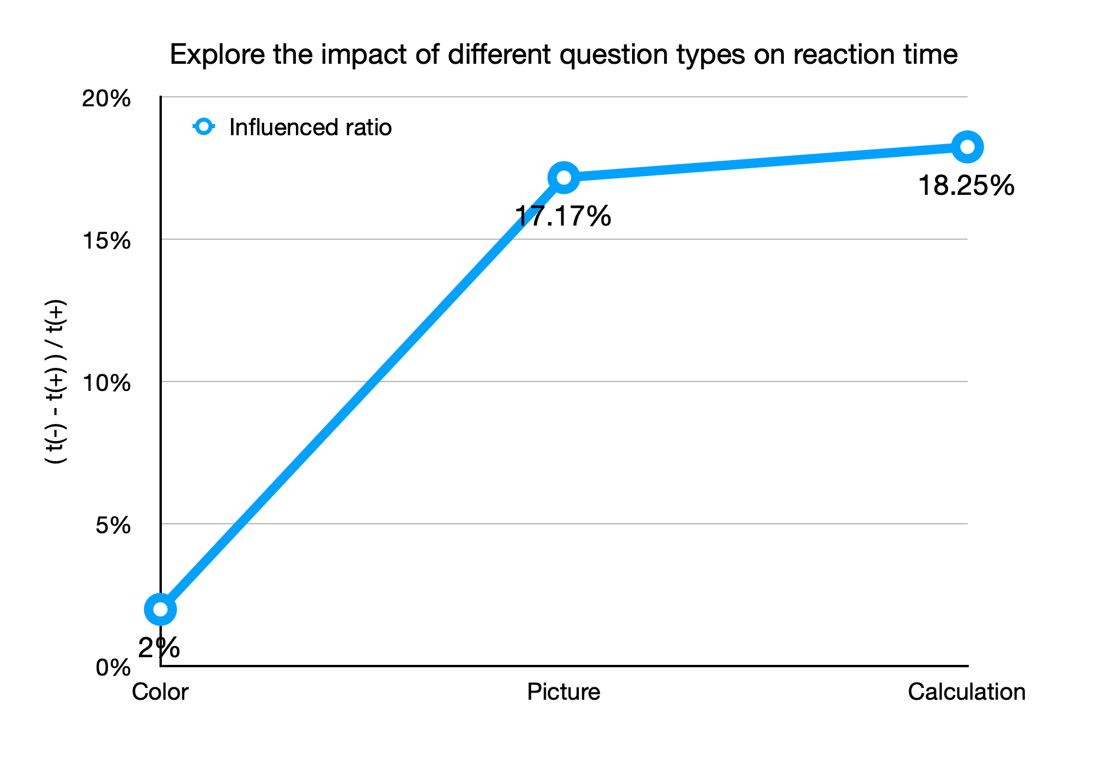
Analysis of the Impact of Different Question types：
From Different Feedback Perspective
Notes:
从正中负反馈的影响分析
逻辑思考受到干扰的程度最大，规律性最强，而简单的颜色干扰程度最小，整体呈平稳波动；

Slide 23
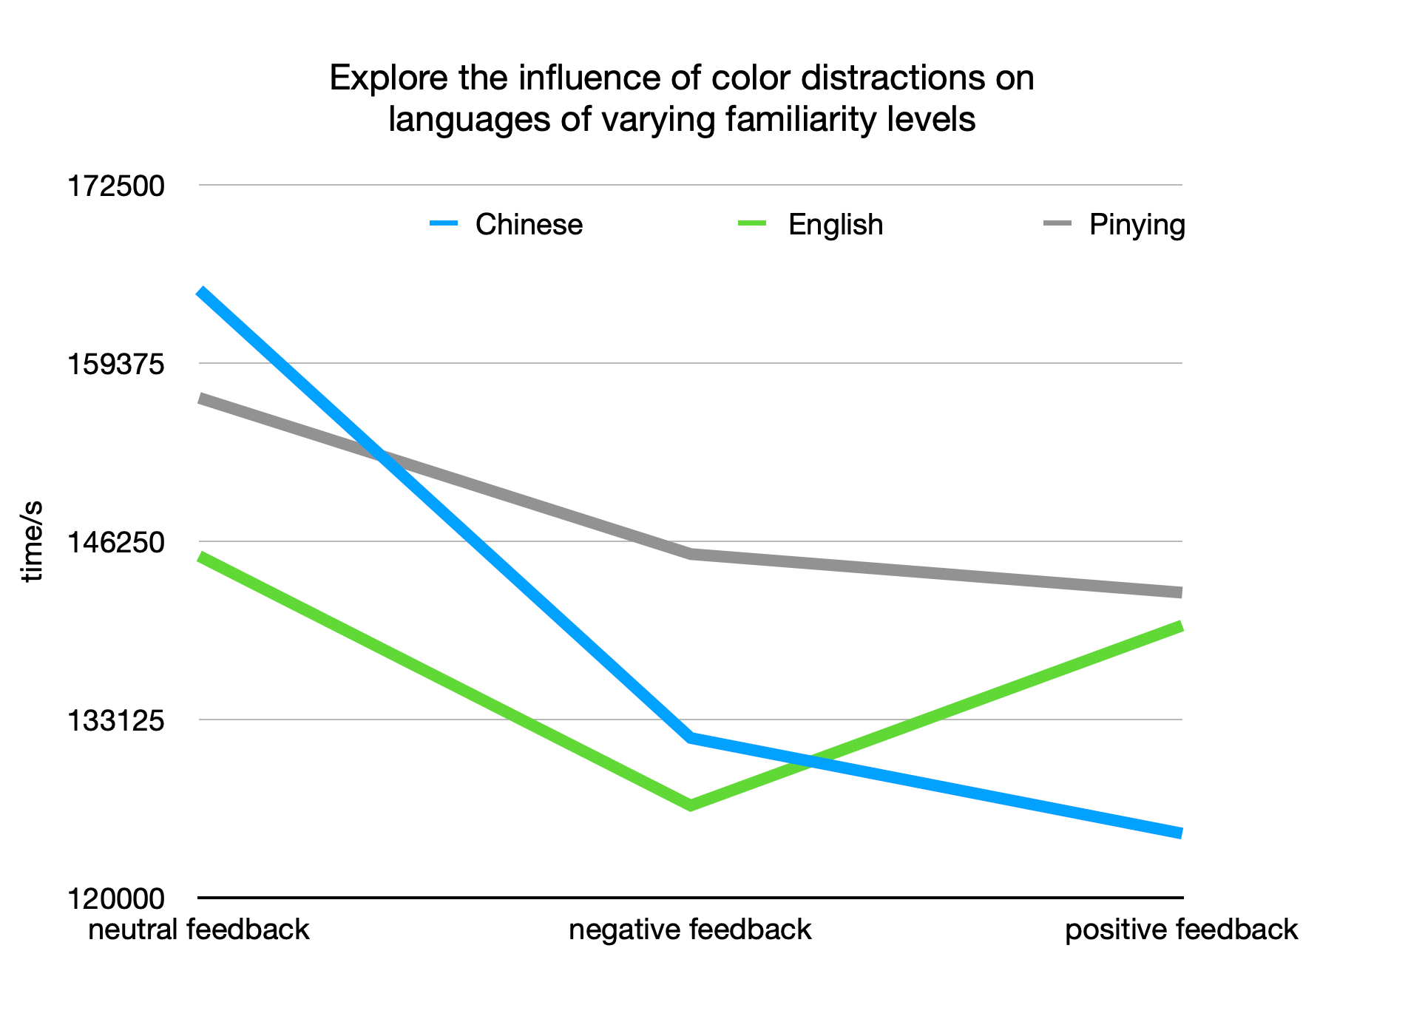
4. Analysis of Language with Different Familiarity Levels being Disturbed by Color
Notes:
分析三：不同熟悉程度的语言受颜色干扰的分析
从整体反应速度来看，拼音的时间耗时最长，而中文和英语差距不大，和平时的接触频率呈相关变化趋势；而总体上中文和拼音受到正负干扰的影响较小，可能是因为语言接触时间的历史较长，反而不容易受到外界干扰。

Slide 24
Part 5:
Summary
This part we will summary the findings.
E

Slide 25
Things To Improve
Small sample size
The comparison experiment is not sufficient, which makes the conclusions reached are not so convincing
Notes:
如基础测试可以考虑增加“选出颜色对应的颜色文字”一类题目，题目出现顺序可以更加随机，有一些外在的干扰没有被排除，变量控制并没有达到完美效果,实验原本的设计过于理想化

Slide 26
About Disturb
First
Experiments have shown that various negative stimuli have a negative impact on people‘s cognitive response time, and the degree is related to the type of interference; as for the promotion effect of positive stimuli, the effect is less obvious than that of negative
FINDINGS
About Adaptability
Second
The speed of people‘s cognitive responses has increased over time and practices, while the degree of cognitive goals will vary with different cognitive goals.
About Complexity
Third
People's familiarity and acceptance of cognitive things will affect the actual effect of different interferences, and human cognition is also a too complex process to be simply templated, which will be subject to a lot of subjective correction and influence,
Notes:
实验表明各种负向刺激，都对人的认知反应时间有负面影响，程度与干扰类型有关；而至于正向刺激的促进作用，效果相较于负向偏不明显
人的认知反应速度随着时间的推移和实践次数的增加，都有一定的提升，而不同的认知目标提升程度则会有所不同
人对认知事物的熟悉程度和接纳度，也会影响到不同干扰的实际作用效果（针对语言）;而人的认知也是一个非常复杂的过程，其中会受到很多主观上的纠正和影响，不能简单模版化（针对计算题的提示）

Slide 27
THANK YOU FOR WATCHING

